Slide 2
Secondary Systems
October 2025

Slide 3
Agenda:
Welcome
Info Session Goals
Project Overview
Discuss Survey Results
Timeline and Next Steps
10/24/2025

Slide 4
Goals of this Meeting
Understand the difference between Empowering UF (E-UF) project activities and secondary systems
  Understand your role in managing changes to secondary systems
Know where to find information, support resources, and updates on what’s coming next

Slide 5
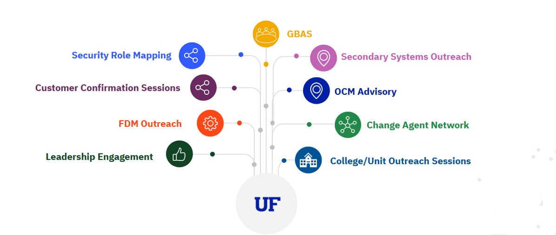
Empowering UF Engagement Activities
We are engaging stakeholders at all levels through multiple forums, sharing initiative updates and gathering feedback to help shape new ways of working. ​
Today’s Focus

Slide 6
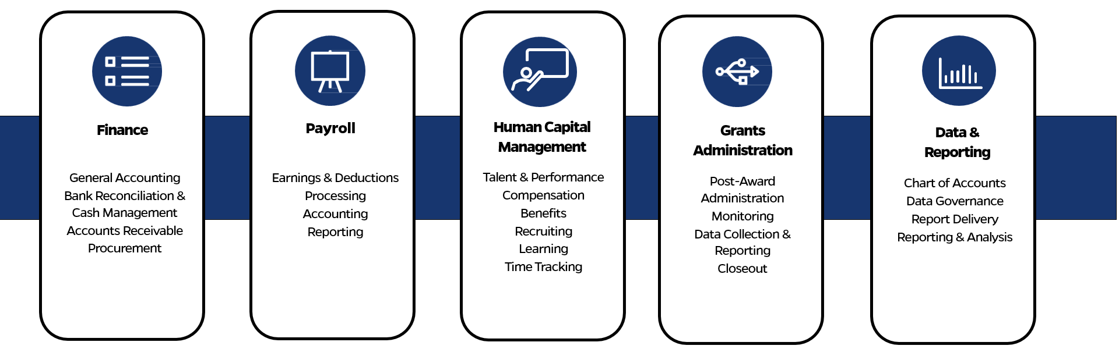
Enterprise Resource Planning Scope
UF’s Enterprise Resource Planning (ERP) system provides critical support to operate the university.
The functionalities listed below are expected to move to Workday in the summer of 2027.
The goal is to streamline the processes and functionality.​

Slide 7
OneUF Vision and Implementation Scope
Phase 1: FIN + Post-Award Grants & HCM + Payroll Implementation
Phase 2
University of Florida
16 Colleges
150+ Centers
40+ Institutes
40+ Administrative and Academic Support Units
Institute of Food and Agricultural Sciences (IFAS)
DSO/Affiliates using the UF ERP
Cattle Enhancement Board, Inc. (CATTL)
Citrus Research and Development Foundation, Inc. (FCRDF)
UF Development Corporation (UFLDC)
UF Historic St Augustine, Inc. (STAUG)
Florida Foundation Seed Producers, Inc. (FFSPI)
UF Research Foundation, Inc. (UFRFI)
The UF Leadership & Education Foundation, Inc (UFLEF)
UF Investment Corporation (UFICO)
UF Foundation, Inc. (UFFND) & UF Alumni Association, Inc.
4H Club Foundation, Inc.
UF Self-Insurance Program + Healthcare Education Insur. Co.
DSO/Affiliates not using UF or Shands ERP
The University Athletic Association, Inc.
Gator Boosters, Inc.
Faculty Associates, Inc. (Dentistry)
Florida Clinical Practice Association, Inc.
Florida Veterinary Medicine Faculty Association, Inc.
UF College of Pharmacy Faculty Practice Association, Inc.
Faculty Clinic, Inc.
Florida Health Professions Associations, Inc.
UF College of Nursing Faculty Practice
DSO/Affiliates using Shands ERP for FIN
GatorCare Health Management Corporation
UF Jacksonville Physicians, Inc.
Shands Jacksonville HealthCare, Inc.
Shands Teaching Hospital and Clinics, Inc.
TBD

Slide 8
Empowering UF Portfolio
Empowering UF
Workday Implementation
All work that directly contributes to the prep and Implementation of Workday
Portfolio
Programs
Projects
Companion Projects
(58 enterprise level)
All enterprise systems that need to change for the new ERP
Data Modernization
Empowering UF Data Warehouse
All data warehouse related work that directly contributes to the preparation and implementation of Workday
Modernize Data & Analytics
Data and Analytics Platform projects that primarily support the UFIT goal of Advance an Analytics-Enabled Environment.
1
2
3
4
Secondary Systems
(119 unit level)
All unit systems that need to change for the new ERP
NOTE: Streamlining Academic Systems, or SAM, UF’s initiative to modernize and integrate UF’s academic systems is outside of this initiative.

Slide 9
Empowering UF Guiding Principles
Transform Business Processes
Engage the UF Community
Create Commonality
Consolidate Systems
Increase Access to Data
Provide unified and modern business processes that promote an elevated enterprise-wide experience for the next 20 years
Promote enterprise-wide engagement to adapt UF policies and practices while providing critical support and information, and care to university stakeholders through robust change management practices
Implement administrative systems utilizing vendor best practices that design for the rule, not the exception
Streamline functionality by minimizing bolt-on applications, shadow systems, and secondary systems
Increase timely access to quality data and reports to support decision making
Project Critical Success Factors Include:
Change Management
Business Process Engineering
Reporting & Data

Slide 10
Decision-Making North Stars
1
2
3
4
Participate in UF citizenship with the greater good in mind
Prioritize the end-user experience for different personas
Workday First – start with leading practices, and ask
“why not?”
Empower the community with timely access to quality information
5
6
7
Provide clarity around decision-making, and support decisions once they’ve been made
As common as possible, as different as required (80/20)
On time, on budget, and in compliance with laws and regulations

Slide 11




Survey Results
Last fall, the Empowering UF program gathered a list of systems being used outside of myufl (PeopleSoft). The survey revealed items that will be addressed in one of the following four ways:
Empowering UF Project
College or Department
Enterprise Systems and Integrations
Secondary Systems
If an enterprise-wide system will be integrated with Workday,
the EmpoweringUF team will develop the integration.
Visit the project website for updates and more information: empowering.ufl.edu (MyUF marketplace, CrossLab/iLab, etc.)
Systems that supplement the main ERP system, providing additional capabilities, working alongside the enterprise applications.
Owned and operated at the unit level (not enterprise systems)
This will be our primary focus of future meetings
Data Feeds via UF One Lake
Intended for technical users
To join the UF data community, visit data.ufl.edu, then click on “Onboarding”
Reports
Intended for non-technical users
The Workday Foundation Data Model (FDM) is robust
Project team leads have been reaching out to departments/colleges
Share unique reporting needs via email (empowering@ufl.edu)

Slide 12

Project Timeline
We are here
Go-Live
Program 1 | 2024 |  |  |  |  |  | 2025 |  |  |  |  |  |  |  |  |  |  |  | 2026 |  |  |  |  |  |  |  |  |  |  |  | 2027
Timeline | J | A | S | O | N | D | J | F | M | A | M | J | J | A | S | O | N | D | J | F | M | A | M | J | J | A | S | O | N | D | J | F | M | A | M | J | J | A | S | O | N | D
Workday Implementation | Post-Selection Readiness |  |  |  |  |  | Plan |  | Architect & Configure |  |  |  |  |  |  |  |  |  |  |  | Test |  |  |  |  |  |  |  |  |  |  |  |  |  | Deploy |  | Stabilization |  |  | Optimization
Tenant 1
Tenant 2
Complete Workday
Configuration and Build
02/27/2026
Tenant 3
Secondary System Phases |  |  |  |  |  |  |  |  |  |  |  |  |  | Plan & Analyze | Design/Build | Test | Deploy | Stabilization
Review systems and decide on a solution
Implement the solution or prepare to retire system
Verify deployment readiness
Post Go-Live assessment and support

Slide 13
Next Steps
Secondary System | 2025 |  |  |  |  |  |  |  |  |  |  |  | 2026 |  |  |  |  |  |  |  |  |  |  |  | 2027
Timeline | J | F | M | A | M | J | J | A | S | O | N | D | J | F | M | A | M | J | J | A | S | O | N | D | J | F | M | A | M | J | J | A | S | O | N | D
Phases |  |  |  |  |  |  |  | Plan & Analyze |  |  |  |  |  | Design/Build |  |  |  |  |  |  |  |  |  |  | Test |  |  |  | Deploy |  | Stabilization
Discovery Meetings
October 2025 to January 2026
Monthly Forums
Begins January 28, 2026
(last Wednesday of the month)
Discovery Meeting Sample Agenda
Introductions
Survey Results Overview
  Discuss your needs
  Confirm what will be retired vs. Remediated
  Recertify the list
Next steps
Monthly Forum Sample Agenda
E-UF Project Team Presentation:
Workday Functionality
  FDM structure (January 2026)
  FDM values (Future Meeting/TBD)
Questions and Discussion
Topics for the next meeting
Timeline review and status updates

Slide 14



We want to hear from you!
Email Us
empowering@ufl.edu
Visit Our Website
empowering.ufl.edu
Share Your Feedback
Suggestions and questions

