Slide 1
ERP Overview
UF’s Enterprise Resource Planning (ERP) system provides critical support to operate the university. A readiness assessment has been conducted to understand how UF’s business processes and administrative systems may be modernized to better serve the institution.
Payroll
Human Capital Management
Grant Administration
Data & Reporting
Finance
Earnings & Deductions
Processing
Accounting
Reporting
Talent & Performance
Compensation
Benefits
Recruiting
Learning
Time Tracking
Post-Award Administration
Monitoring
Data Collection & Reporting
Closeout
Chart of Accounts
Data Governance
Report Delivery
Reporting & Analysis
General Accounting
Bank Reconciliation & Cash Management
Accounts Receivable
Procurement

Slide 2
Why Modernization?
UF will need to invest in replacing aging infrastructure
with modernized business processes and a consolidated administrative system
Aging Legacy System​ Utilizing an 18-year old system, current business process are less efficient and not fully optimized
Decision Making Leadership and staff lack access to quality data, reports, and analytics needed to make timely decisions
Overly Complex The legacy operating environment is complex and increasingly unsustainable due to a multitude of shadow systems and workarounds developed to meet business needs

Slide 3
Benefits of Cloud Modernization
Streamlines and Modernizes
Business Processes
Improves Access to Data and Reporting
Establishes Sustainable Environment
Increases business process consistency across central, schools, and units.
Reduces complexity and increases transparency across decentralized departments
Requires UF’s willingness to change and minimize customizations by business units
Captures advanced capabilities and best practice functionality as software vendors invest R&D in development of cloud platform functionality
Reduces need for maintenance as cloud technology is continually upgraded and improved to align to changing business needs and external factors in the market
Enhances self-service reporting and analytical capabilities while increasing the transparency of the data through dashboards
Supports strategic decision making at the staff level through data-driven analytics

Slide 4
One UF Vision and Phasing Scope
Phase 1: FIN + Post-Award Grants & HCM + Payroll Implementation
Phase 2
Campus Proper
16 Colleges
150+ Centers
40+ Institutes
40+ Administrative and Academic Support Units
Institute of Food and Agricultural Sciences (IFAS)
Affiliated Organizations On UF ERP for FIN
Cattle Enhancement Board, Inc. (CATTL)
Citrus Research and Development Foundation, Inc. (FCRDF)
UF Development Corporation (UFLDC)
UF Historic St Augustine, Inc. (STAUG)
Florida Foundation Seed Producers, Inc. (FFSPI)
UF Research Foundation, Inc. (UFRFI)
The UF Leadership & Education Foundation, Inc (UFLEF)
UF Investment Corporation (UFICO)
UF Foundation, Inc. (UFFND) & UF Alumni Association, Inc.
4H Club Foundation, Inc.
Affiliated Organizations Not On UF or Shands ERP for FIN
The University Athletic Association, Inc.
Gator Boosters, Inc.
Faculty Associates, Inc. (Dentistry)
Florida Clinical Practice Association, Inc.
Florida Veterinary Medicine Faculty Association, Inc.
UF College of Pharmacy Faculty Practice Association, Inc.
UF Self-Insurance Program + Healthcare Education Insur. Co.
Faculty Clinic, Inc.
Florida Health Professions Associations, Inc.
UF College of Nursing Faculty Practice
Affiliated Organizations Using Shands ERP for FIN
GatorCare Health Management Corporation
UF Jacksonville Physicians, Inc.
Shands Jacksonville HealthCare, Inc.
Shands Teaching Hospital and Clinics, Inc.
The Student Information System (SIS) is not in scope for the Phase 1 or Phase 2 implementation.
Modernization to SIS will eventually be required.
Additional improvements to the IT Landscape will continue to be explored throughout this effort.

Slide 5
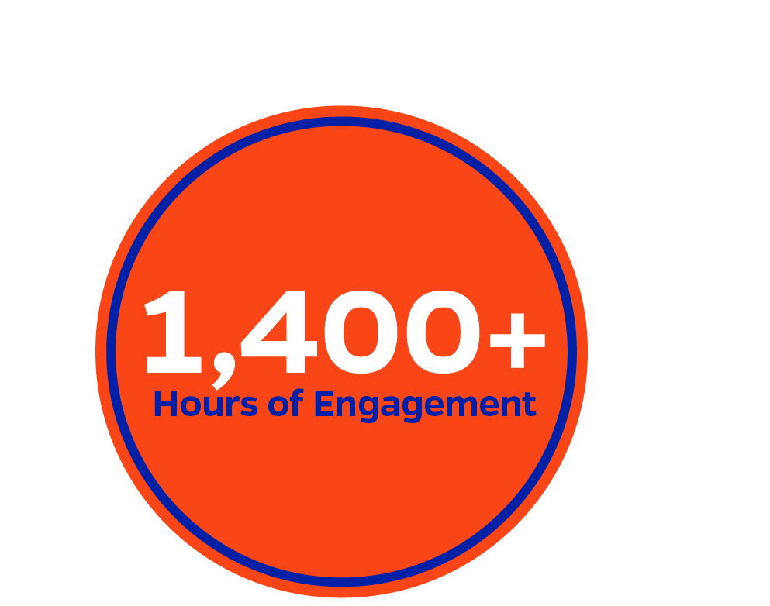
Readiness Assessment Engagement
300+ Participants
Core Offices
DSOs
Campus
39 Workshops and Interviews
Including Business Process Maturity, Chart of Accounts, and Data & Reporting
70+ Campus Units
Colleges, DSOs, and Affiliated Organizations

Slide 6
Stakeholder Interview Emerging Themes
Campus
Campus Units; Student Administration/ Student Success; Deans of large, small, and professional colleges
DSOs
Athletic Association, UF Investment Corporation; UF Foundation (Advancement)
Health
Shands Teaching Hospital; Shands Jax Healthcare; UF Jax Physicians; Florida Clinical Practice Association
Enthusiasm of Staff
Staff welcome modernization, but need robust training and transparency
Lacking Integration of Data
HR and FIN systems are not well integrated, creating inefficiencies
Delayed Data Informed Decisions
Data extraction and analysis are not real-time which hampers decision making with less than accurate information
Reliance on Shadow Systems
Information is tracked outside of the ERP, resulting in cumbersome reporting and multiple sources of truth
Limited Staff Bandwidth
Campus staff is overburdened with concerns around capacity to support the implementation
Insufficient Access to Information
Data extraction requires manual queries and lacks user-friendly, self-service capabilities to access the data
Lacking System Flexibility
Current system is not flexible enough for DSOs to support their unique business needs, resulting in inefficiencies
Desire for Involvement
DSOs have specific business functions within the bounds of the new system which must be considered in the design
Convoluted Data Retention
Data is stored in various locations resulting in multiple sources of truth
Poor Data Visualization
Dashboarding capabilities are lacking and requires units to involve UFIT to interact with the system
Unique Industry Needs
There are nuances for UF Health that need to be included in the design with UF Health involved in the decisions
Manual Consolidated Reporting
Creating a consolidated view is cumbersome and requires UF Health to coordinate with central finance and HR
Potential Initiative Fatigue
Health leaders are worried about staff fatigue as there are already many initiatives going on across UF Health
Interest in COA Consolidation
UF Health is not opposed to sharing a COA for improved system integration
Complex IT Landscape
UF Health has a multitude of systems that require analysis and integration

Slide 7
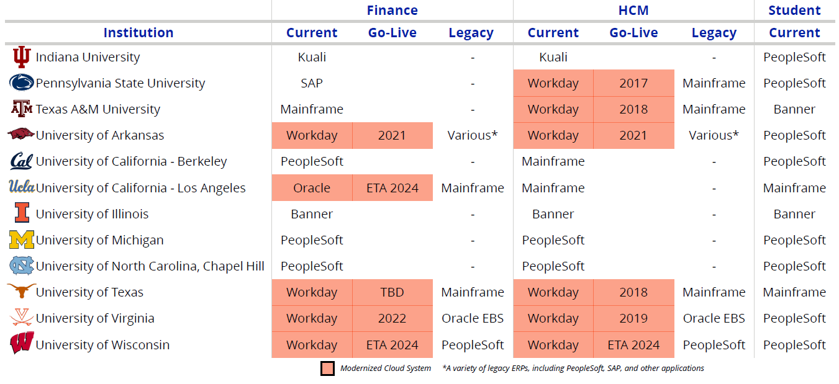
Peer Institutions Modernizing to Cloud-Based Platforms
Highlighted colors indicate the cloud platform modernization is in progress or completed

Slide 8
Implementation Phases Enabled by Global Design
Global Design Strategy: the 30-month timeline for Phase 1 allows time for Phase 2 organizations to be included in system design. This early consideration allows for Phase 2 to be implemented in 18 months.

Slide 9
Subject Matter Experts
Melissa Curry, Interim Vice President
UF Human Resources
Ginger Gibson, Executive Director of Finance, Herbert Wertheim College of Engineering
Stephanie Gray, Associate Vice President
UF Research
Nicole Jeffers, Director
UF Information Technology
Mike Johnson, Interim CFO
UF Foundation
Laura Rosenbury, Dean
College of Law
Kelly Sharp, Associate Vice President
UF Academic Health Center
Melissa Stuckey, Finance Director University Athletic Association
Meena Thiyagarajah, Director of Finance UF IFAS
Olga Weider, Controller
Office of the UF CFO

Slide 10
Next Steps
Product demos in January
Select software and implementation partner through a procurement process
Explore partnership opportunities with Florida SUS institutions

